Slide 1
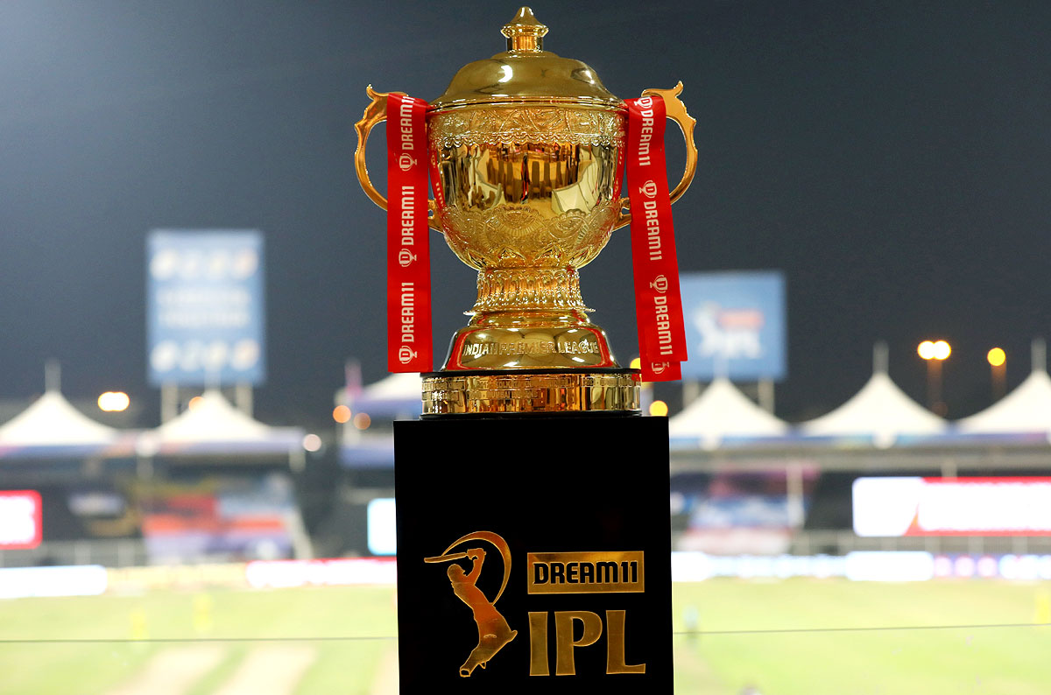
DATA ANALYSIS OF TWO BATSMEN IN IPL

Slide 2
CONTENT
Key Factors considered for selecting MSD and DK Datasets
Essential libraries for this Project
Data Preparation and Cleaning
Data Analysis
Comparing the Results
Observation of Average and Strike Rate
Wicketkeeping performance
Inference
Conclusion

Slide 3
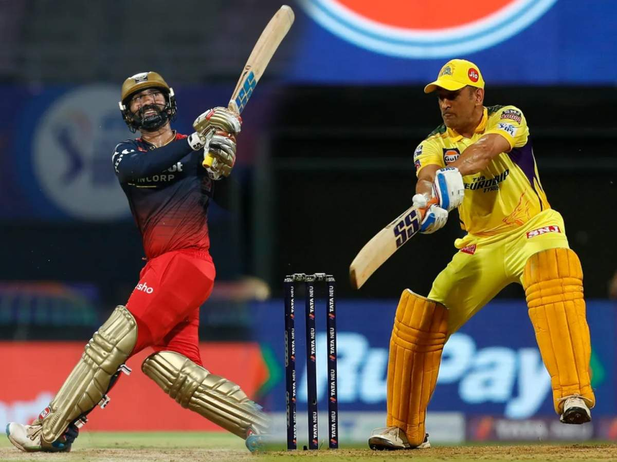
KEY FACTORS CONSIDERED FOR SELECTING MSD (Mahendra Singh Dhoni) AND DK (Dinesh Karthik) DATSETS
IPL Debut: Both MSD and DK made their IPL debut in 2008, the inaugural season of the league. They have been playing in the league since then and have been a consistent presence in their respective teams.
Wicket-Keeping: Both MSD and DK are wicket-keepers and have played a significant role in their team's success in the IPL.
Batting Style: Both MSD and DK are right-handed batsmen who are known for their aggressive batting style. They are capable of hitting big sixes and scoring quick runs, making them valuable assets for their teams.
Experience: Both MSD and DK have played in the IPL for over a decade and have a wealth of experience in the league. They have faced some of the best bowlers in the world and have performed consistently over the years.
ADDITIONAL KEY FACTOR
Captaincy: Both MSD and DK have captained their respective IPL teams. MSD has been the captain of the Chennai Super Kings (CSK) since the first season, leading them to three IPL titles. DK has also captained several IPL teams, including the Kolkata Knight Riders (KKR) and the Gujarat Lions (GL).

Slide 4
ESSENTIAL LIBRARIES FOR THIS PROJECT
Numpy
Pandas
Matplotlib
Seaborn

Slide 5
DATA PREPARATION AND CLEANING
To make it look better and to analyze the dataset easily.
clean empty cells, wrong data and unusual data.
check any duplicate data in our dataset.
M S Dhoni and Dinesh Karthik are not bowlers, the column related to bowlers are removed.

Slide 6
DATA ANALYSIS
Against Opponent Team
Matches played
Innings Played
Runs Scored
Strike Rate
Average
High Score

Slide 7
Ground Analysis
Matches Played in each ground
Average in each ground
Strike Rate in each ground
Performance by Year
Performance by Batting Position
Performance by Match Result

Slide 8
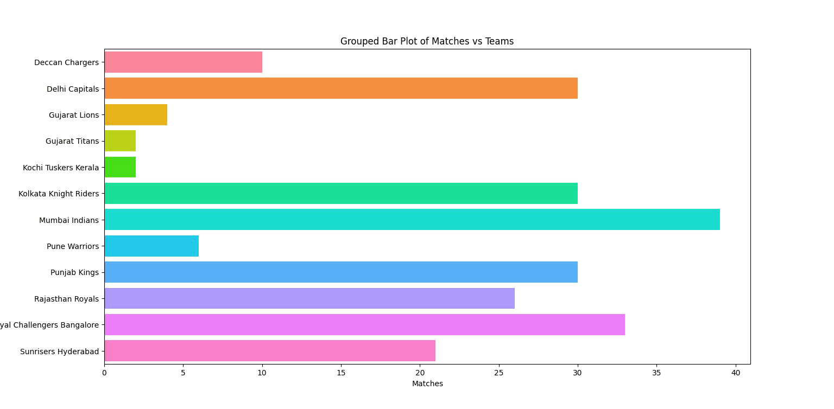
MSD AGAINST OPPONENT TEAM
MATCHES PLAYED

Slide 9
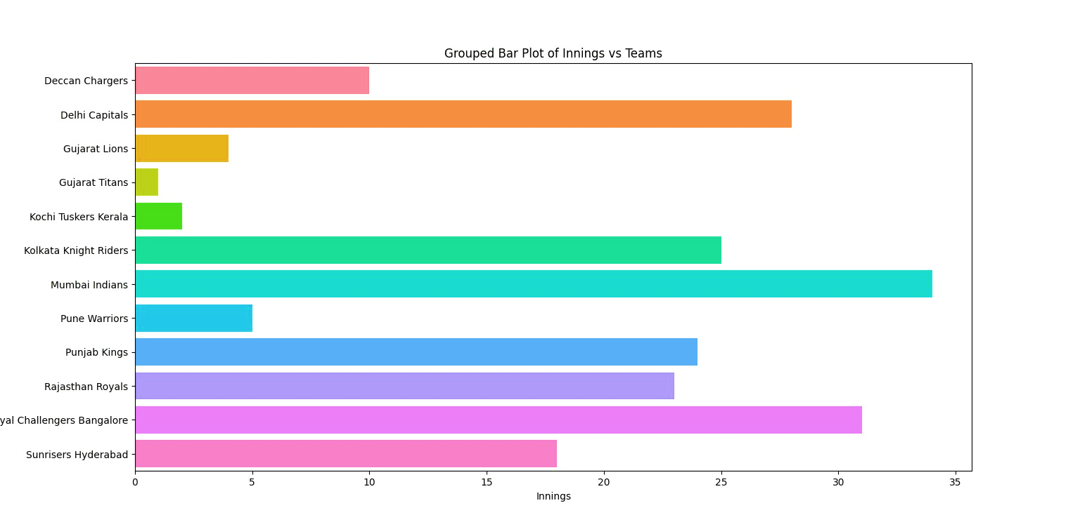
MSD AGAINST OPPONENT TEAM
INNINGS PLAYED

Slide 10
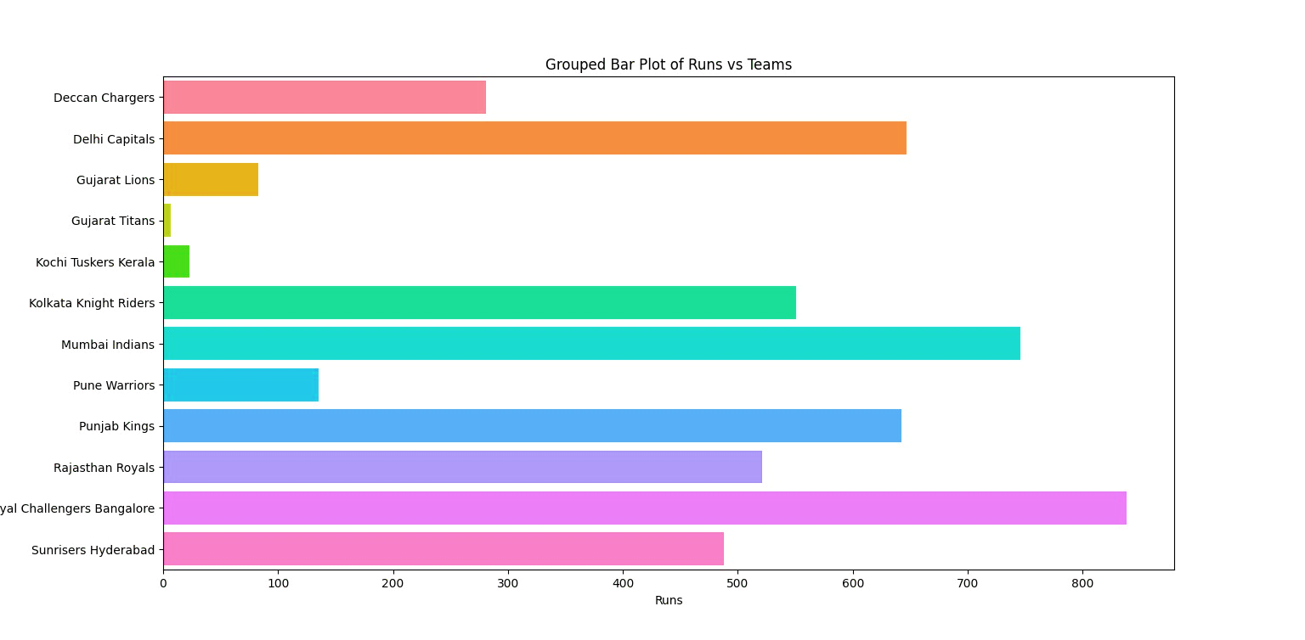
MSD AGAINST OPPONENT TEAM
RUNS SCORED

Slide 11
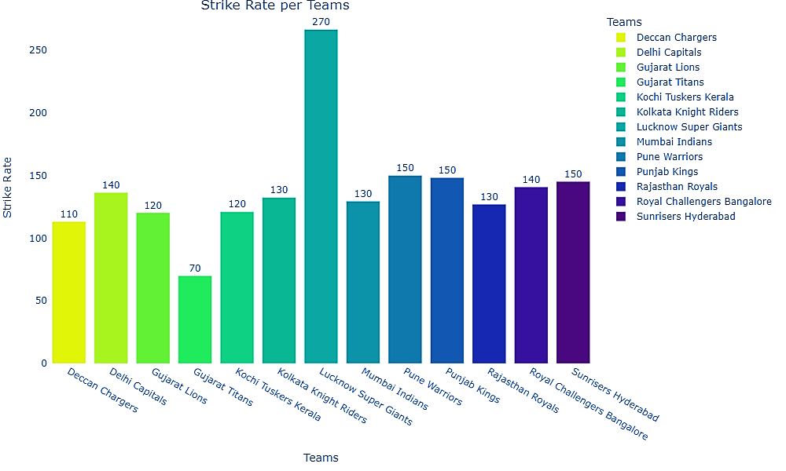
MSD AGAINST OPPONENT TEAM
STRIKE RATE

Slide 12
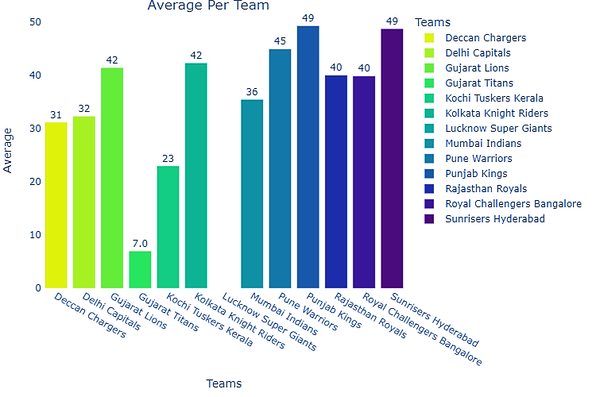
MSD AGAINST OPPONENT TEAM
AVERAGE

Slide 13
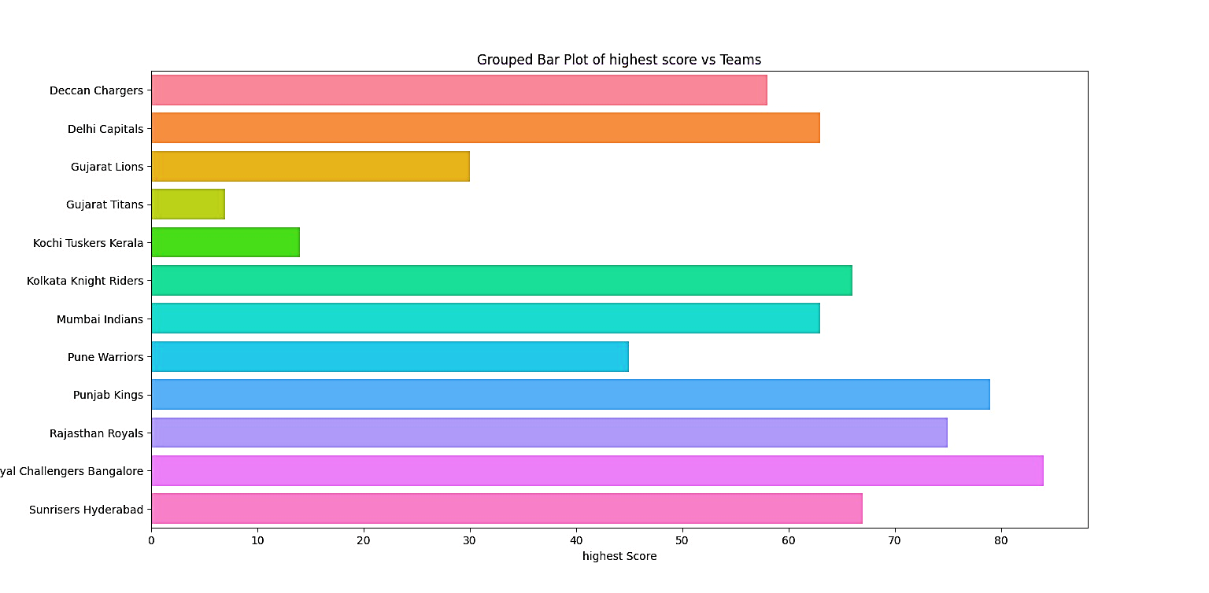
MSD AGAINST OPPONENT TEAM
HIGH SCORE

Slide 14
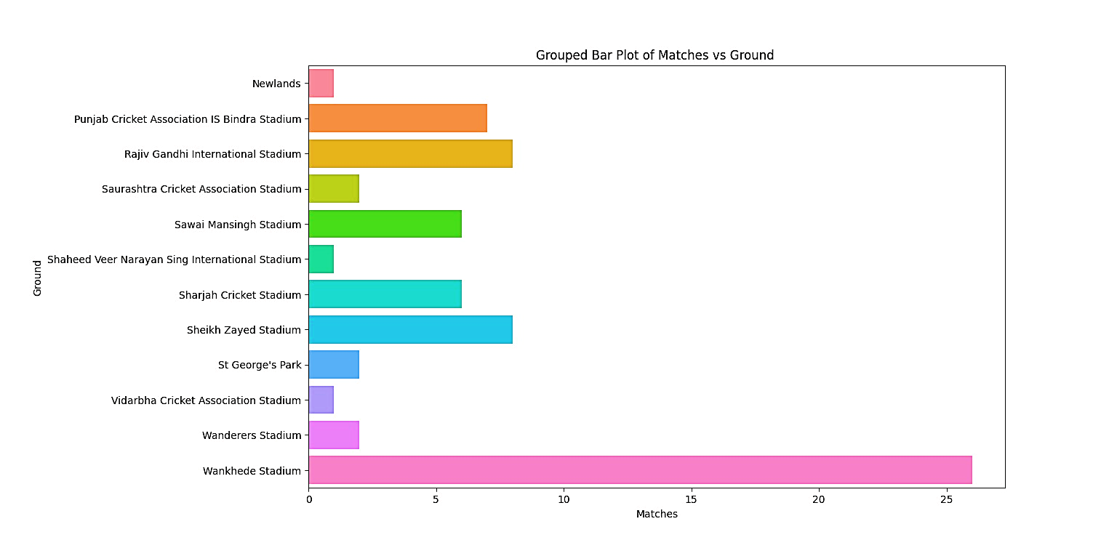
GROUND ANALYSIS FOR MSD
MATCHES PLAYED IN EACH GROUND

Slide 15
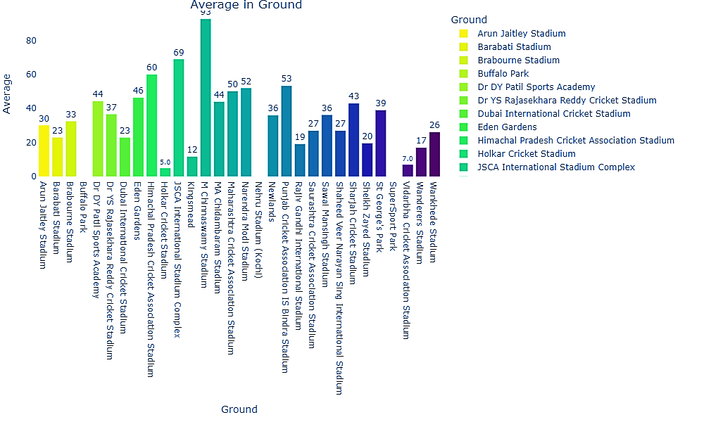
GROUND ANALYSIS FOR MSD
AVERAGE IN EACH GROUND

Slide 16
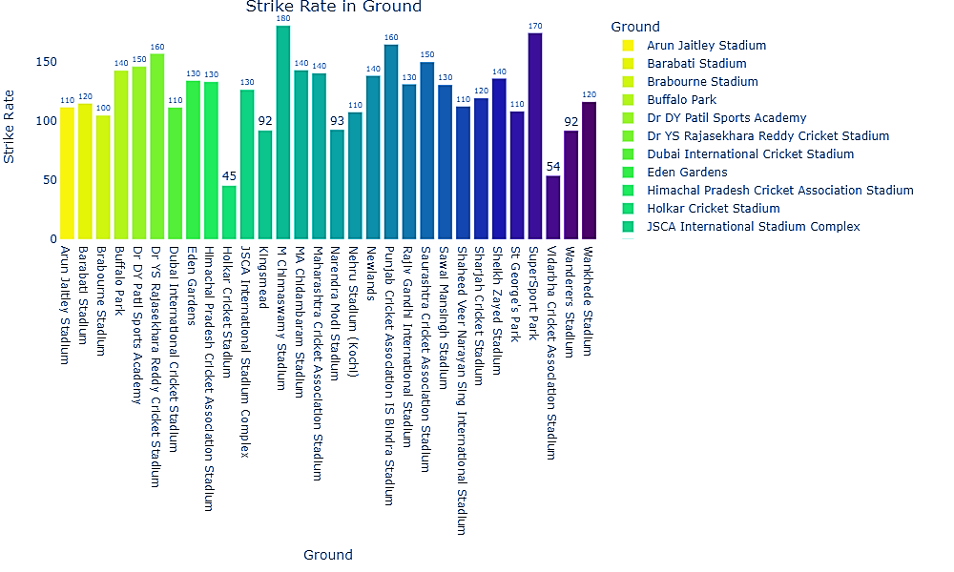
GROUND ANALYSIS FOR MSD
STRIKE RATE IN EACH GROUND

Slide 17
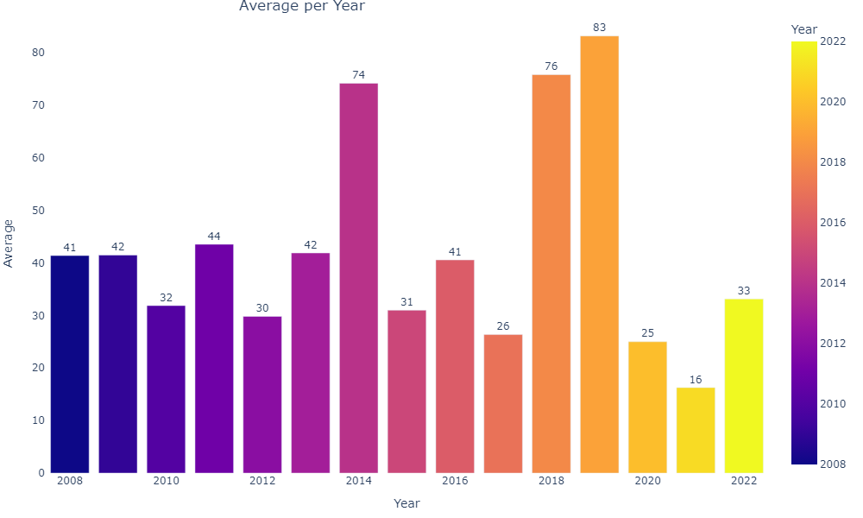
MSD AVERAGE PER YEAR

Slide 18
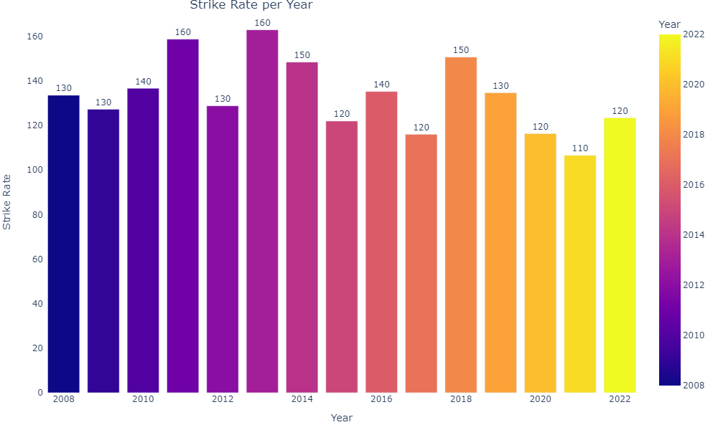
MSD STRIKE RATE PER YEAR

Slide 19
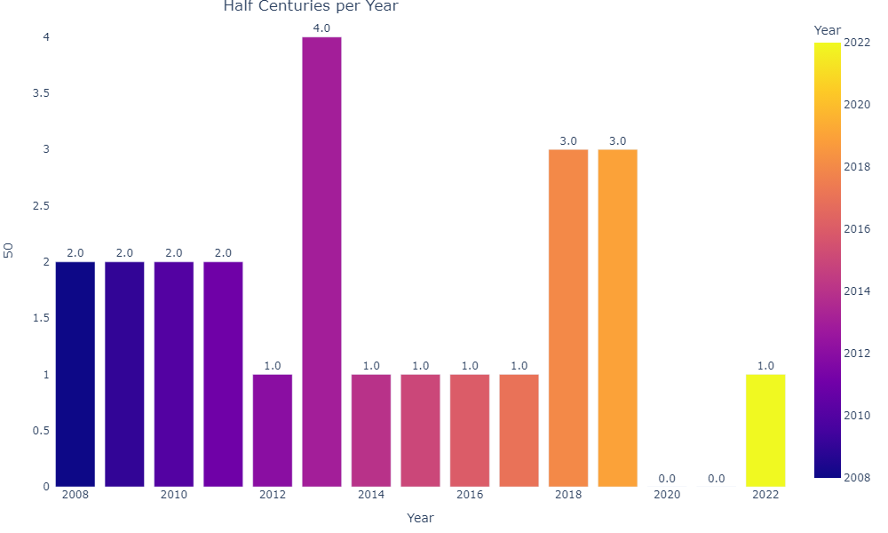
MSD HALF CENTURIES PER YEAR

Slide 20
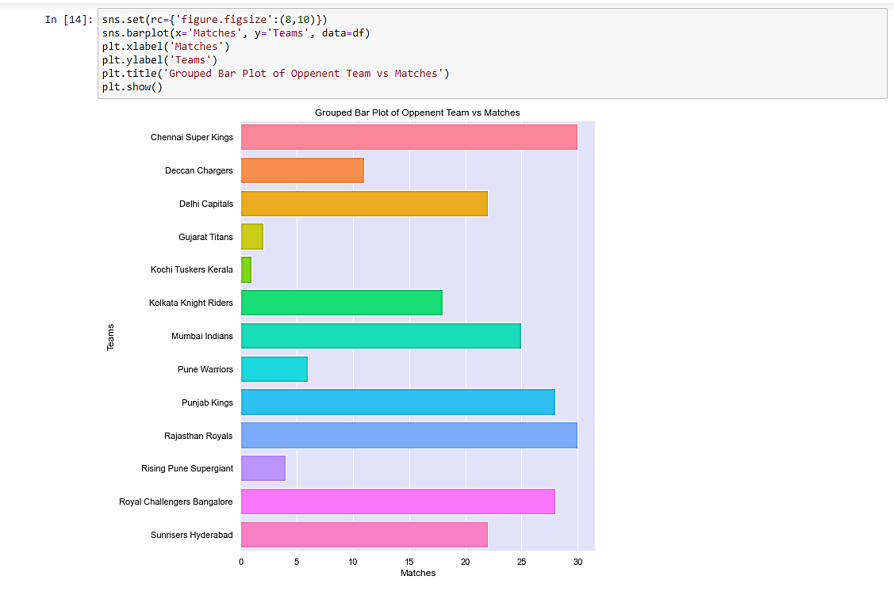
DK AGAINST OPPONENT TEAM
MATCHES PLAYED

Slide 21
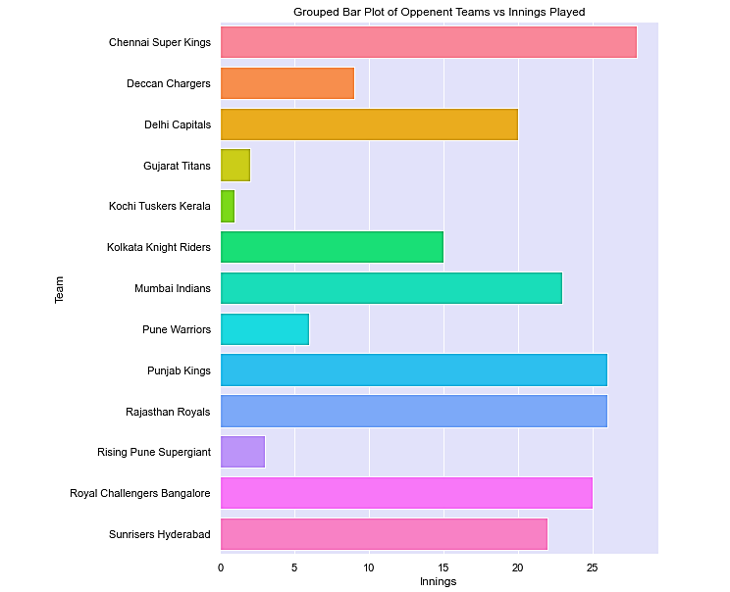
DK AGAINST OPPONENT TEAM
INNINGS PLAYED

Slide 22
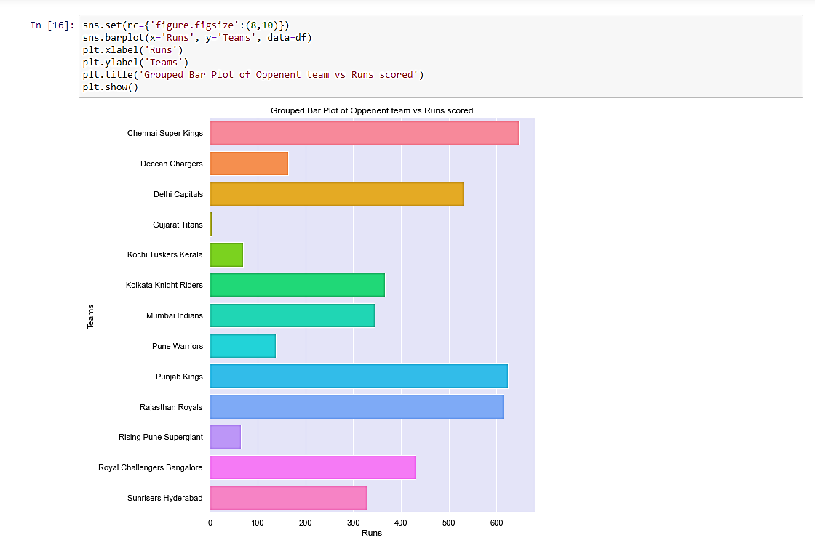
DK AGAINST OPPONENT TEAM
RUNS SCORED

Slide 23
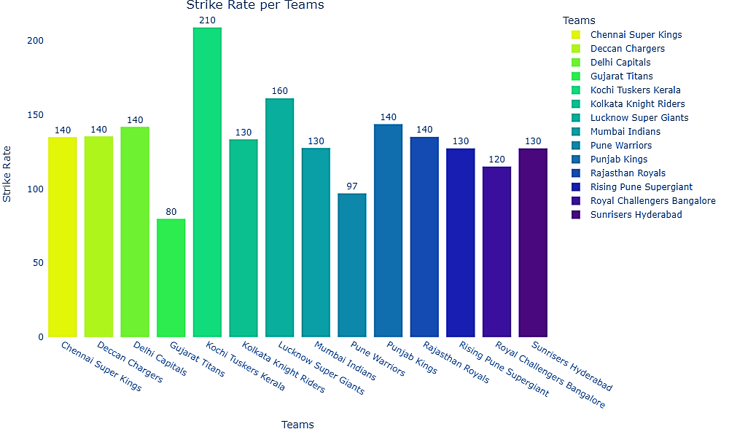
DK AGAINST OPPONENT TEAM
STRIKE RATE

Slide 24
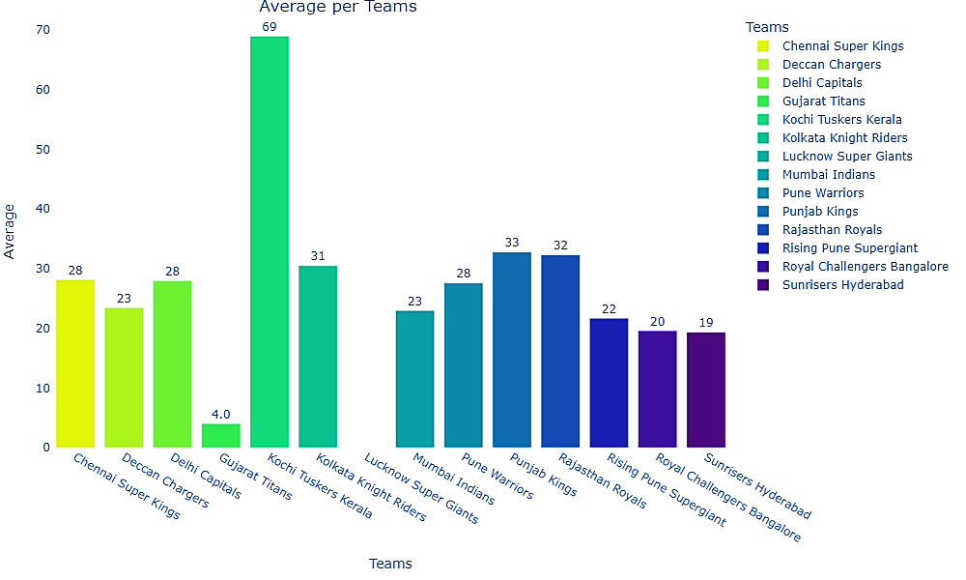
DK AGAINST OPPONENT TEAM
AVERAGE

Slide 25
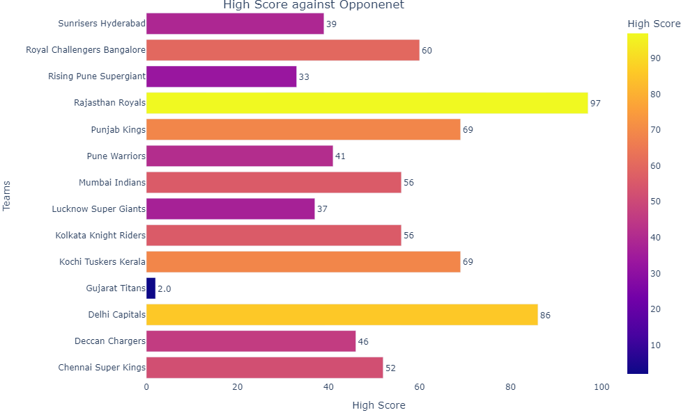
DK AGAINST OPPONENT TEAM
HIGH SCORE

Slide 26
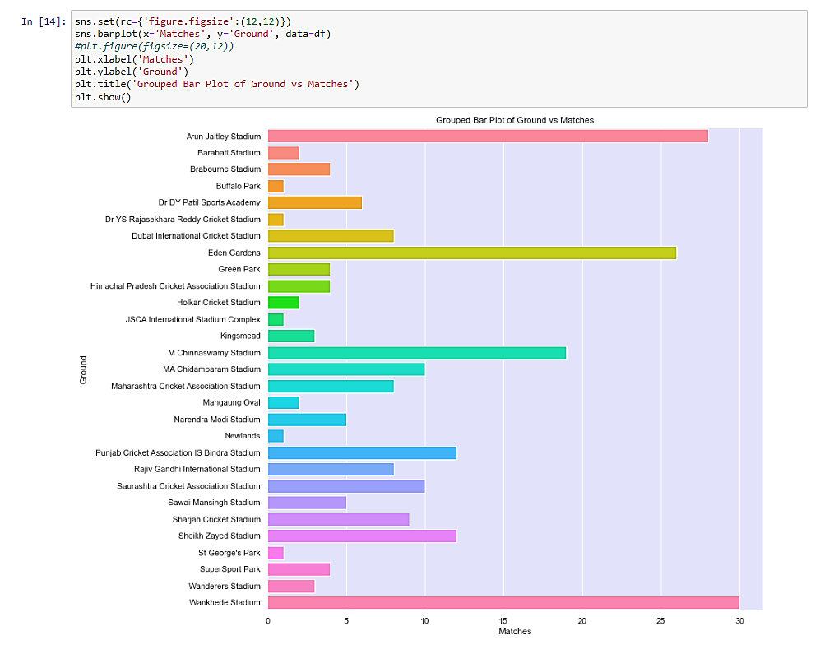
GROUND ANALYSIS FOR DK
MATCHES PAYED IN EACH GROUND

Slide 27
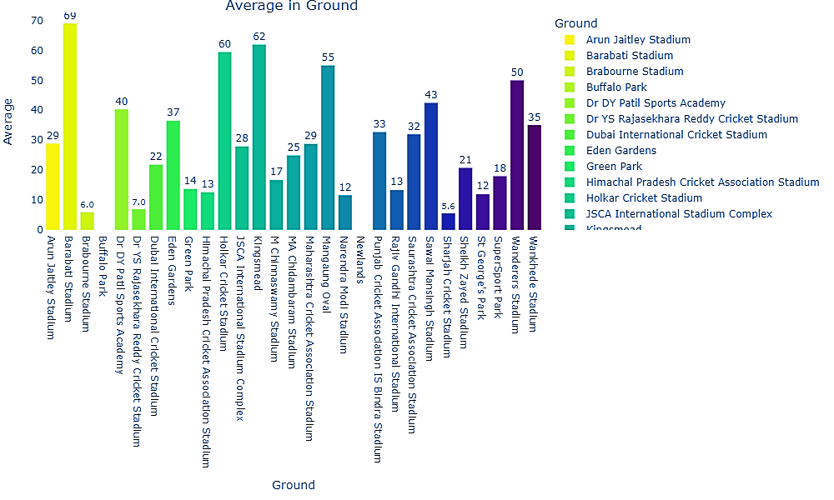
GROUND ANALYSIS FOR DK
AVERAGE IN EACH GROUND

Slide 28
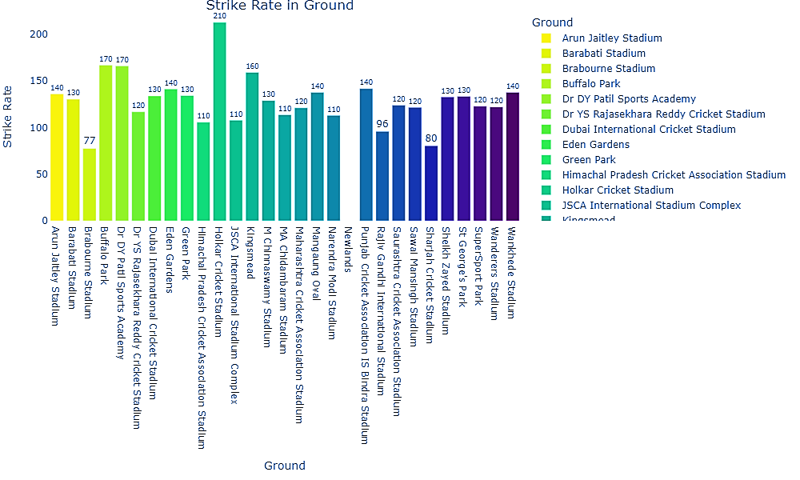
GROUND ANALYSIS FOR DK
STRIKE RATE IN EACH GROUND

Slide 29
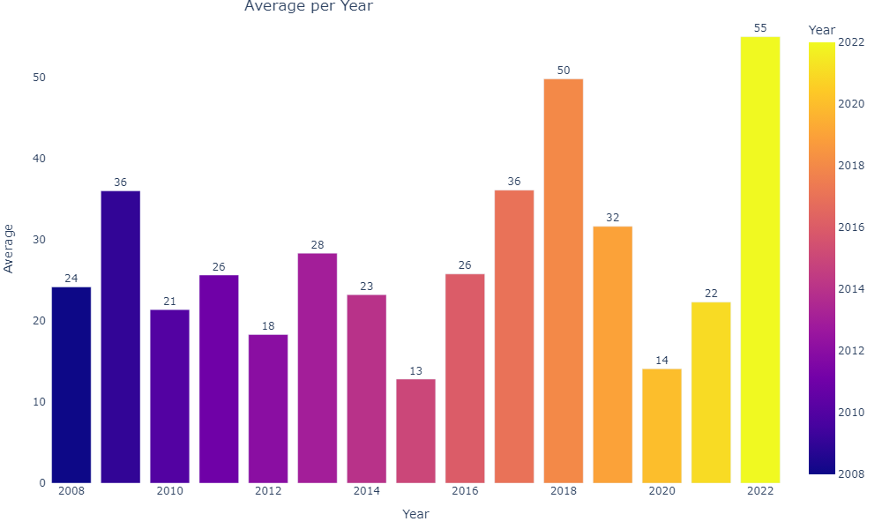
DK AVERAGE PER YEAR

Slide 30
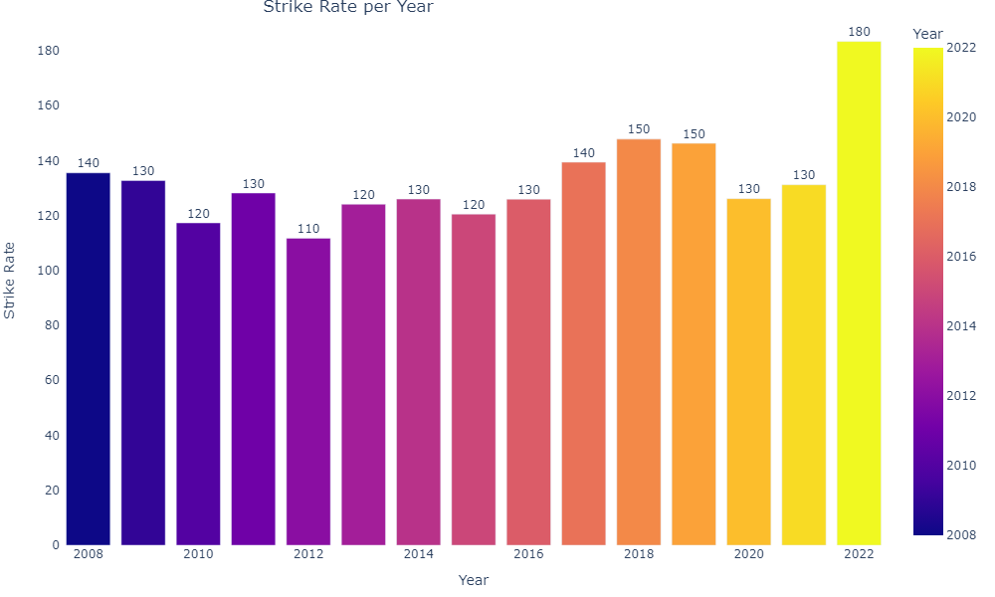
DK STRIKE RATE PER YEAR

Slide 31
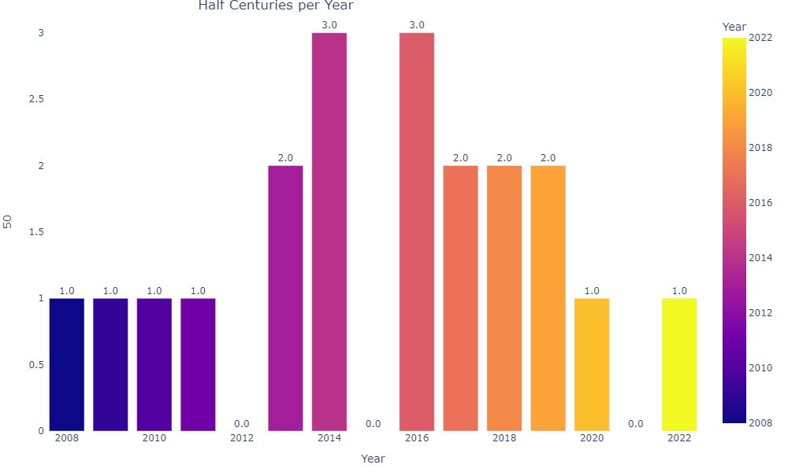
DK HALF CENTURIES PER YEAR

Slide 32
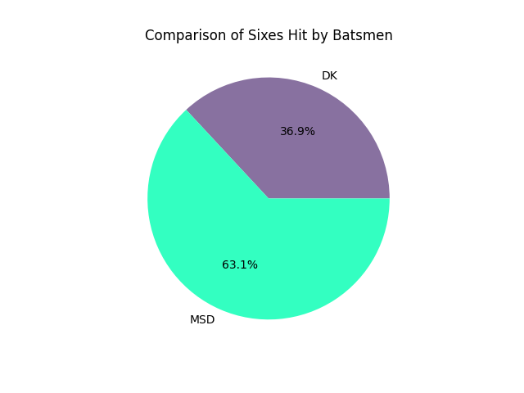
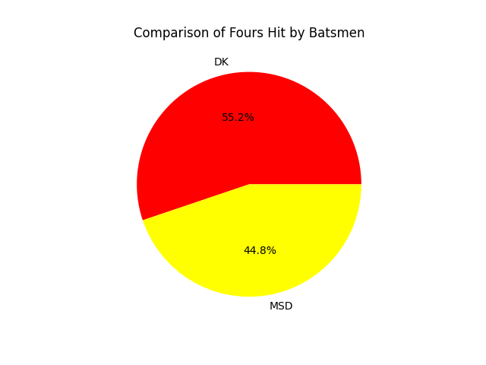
COMPARISON ON BOUNDARIES

Slide 33
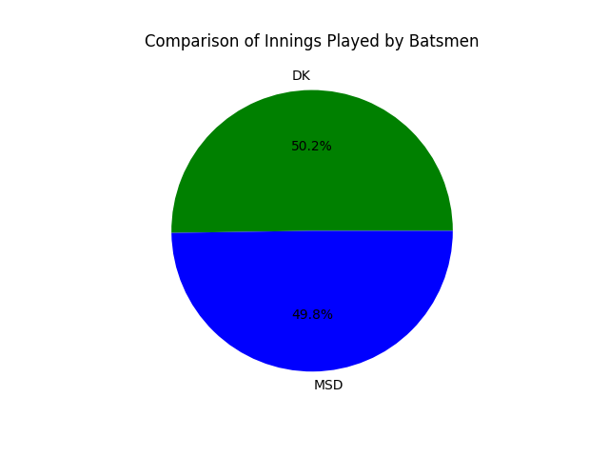
COMPARISON OF INNINGS PLAYED

Slide 34
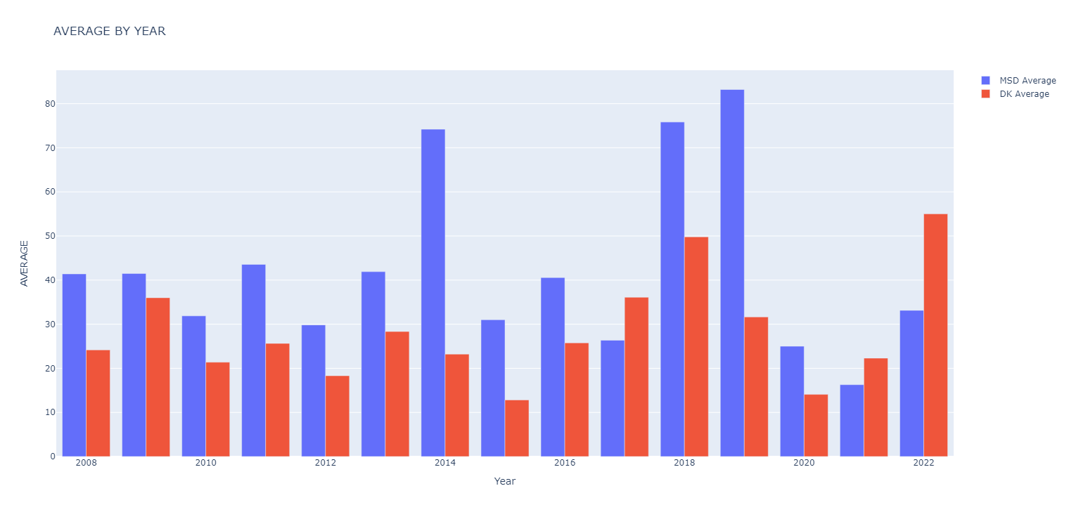
COMPARISON ON AVERAGE

Slide 35
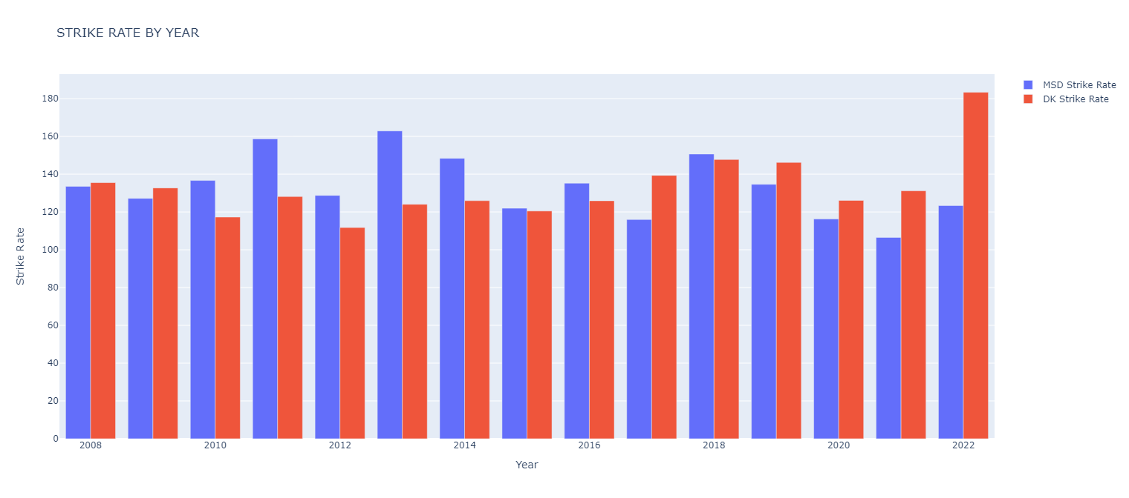
COMPARISON ON STRIKE RATE

Slide 36
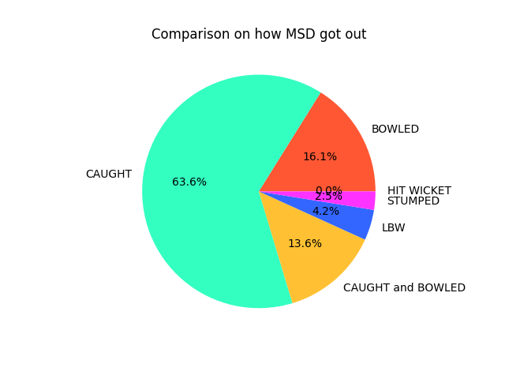
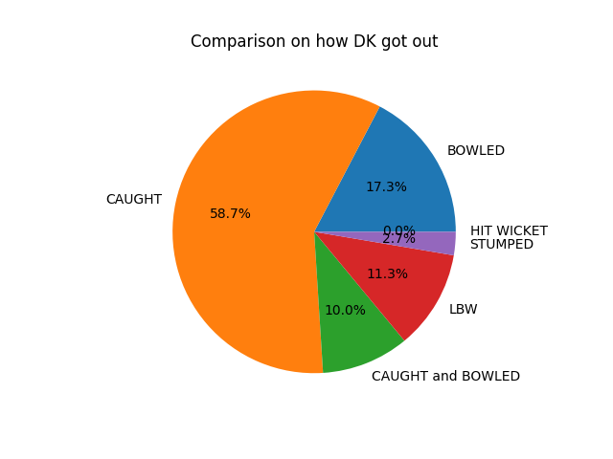
COMPARISON ON GETTING OUT

Slide 37
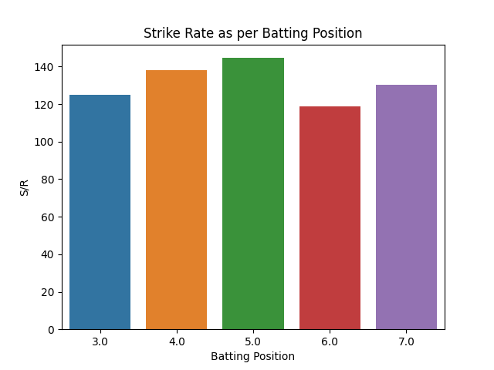
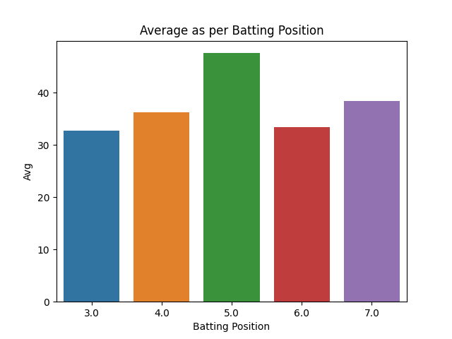
PERFORMANCE BY BATTING POSITION FOR MSD
STRIKE RATE
AVERAGE

Slide 38
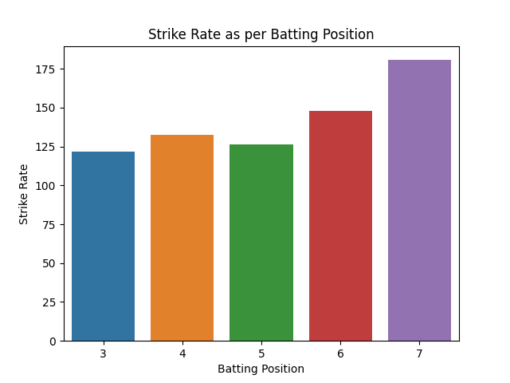
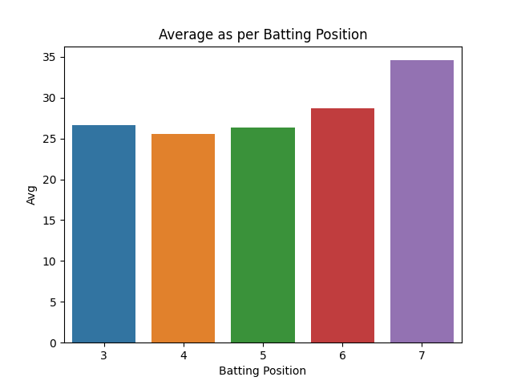
PERFORMANCE BY SUITABLE BATTING POSITION FOR DK
STRIKE RATE
AVERAGE

Slide 39
OBSERVATION ON MSD’s IPL AVERAGE
MS Dhoni has the highest average in IPL against the Punjab Kings team. His average against them is 49.38 in 24 innings.
MSD also scored 5 fifties against Punjab Kings ,most against any team.
MSD had an average of 40 above against KKR, RCB,SRH and RR. He performed consistently against all teams.
MSD also scored 4 fifties against RCB and SRH ,second next to Punjab.
MSD has an average of 47.39 in the result of matches won and an average31.38in the result of matches loss.
MSD has an average of 92.60 on M Chinnaswamy Stadium and more than 50 averages on Himachal Pradesh Cricket Association Stadium, JSCA International Stadium Complex, Narendra Modi Stadium, Maharashtra Cricket Association Stadium, Punjab Cricket Association IS Bindra Stadium which shows combination of spin and pace friendly pitches.
This shows that if MSD performs well then it will be positive result.

Slide 40
OBSERVATION ON DK’s IPL AVERAGE
Dinesh Karthik has an average of 32.79 in IPL against the Punjab Kings team which is the highest against any team he played.
DK scored 5 fifties against Delhi Capitals, most against any team.
DK had an average of 30 above against KKR,SRH and RR.
DK scored 4 fifties against Punjab next to Delhi.
DK has an average of 60 on Barabati Stadium and more than 50 averages on Holkar Cricket Stadium, Sawai Mansingh Stadium, Wanderers Stadium.

Slide 41
OBSERVATION ON MSD’s IPL STRIKE RATE
MS Dhoni has the highest Strike Rate in IPL against the Lucknow Super Giants team. His Strike Rate against them is 266.67, which is most by an player against any team this is because he played only one innings against them.
MSD has the SR of 148.23 in the result of matches won and the SR of 120.00 in the result of matches loss.
MSD has the Strike Rate of above 140 against RCB,SRH and PK.
MS Dhoni has the Strike Rate of 180.86 on M Chinnaswamy Stadium and good average on most of the ground he played more than 2 matches.
Dhoni has performed consistently against all teams but has the lowest Strike Rate against RR and GT.

Slide 42
OBSERVATION ON DK’s IPL STRIKE RATE
DK has the highest Strike Rate of 143.88 against Punjab Kings and the Strike Rate of above 135 against CSK, DC and RR.
DK has the SR of 148.23 in the result of matches won and the SR of 120.00 in the result of matches loss.
DK has the lowest Strike Rate against GT,MI,SRH but not less than 120.
DK has the Strike Rate of 212.50 on Holkar Cricket Stadium and notable Strike Rate on DYPatil and Wankhede
Stadium.

Slide 43
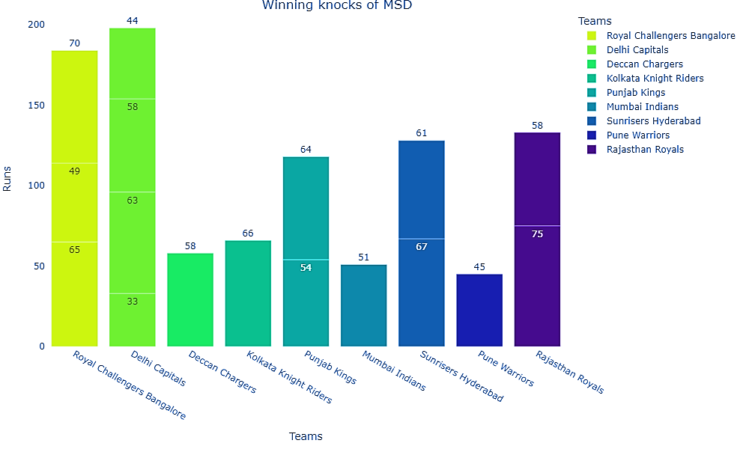
MATCH WINNING KNOCKS OF MS DHONI

Slide 44
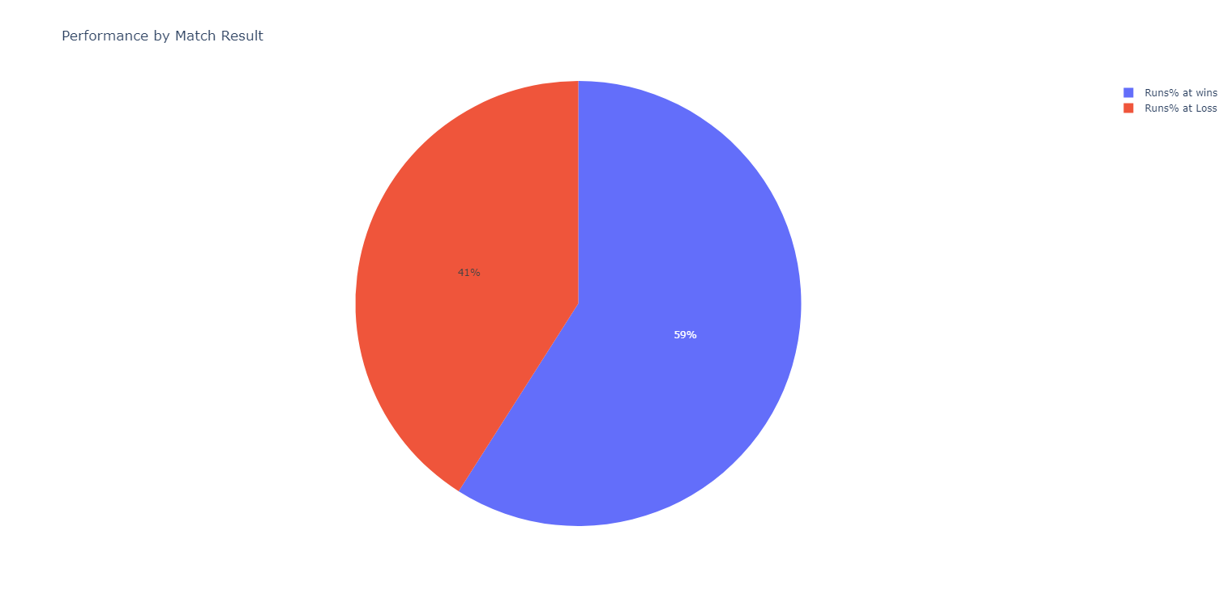
RATIO OF RUNS RESULTING THROUGHOUT THE IPL CAREER OF MSD

Slide 45
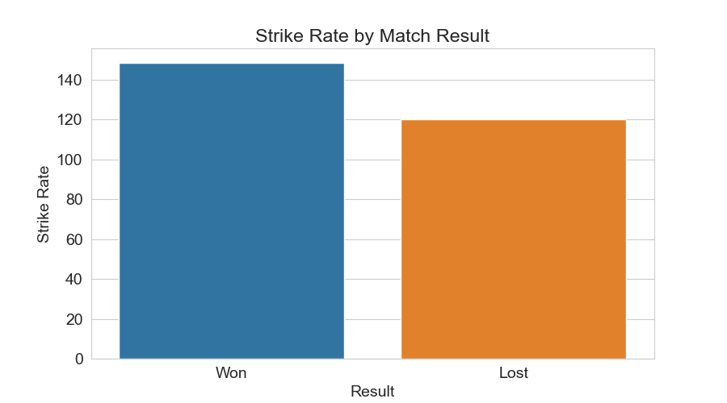
STRIKE RATE RESULTING THROUGHOUT THE IPL CAREER OF MSD

Slide 46
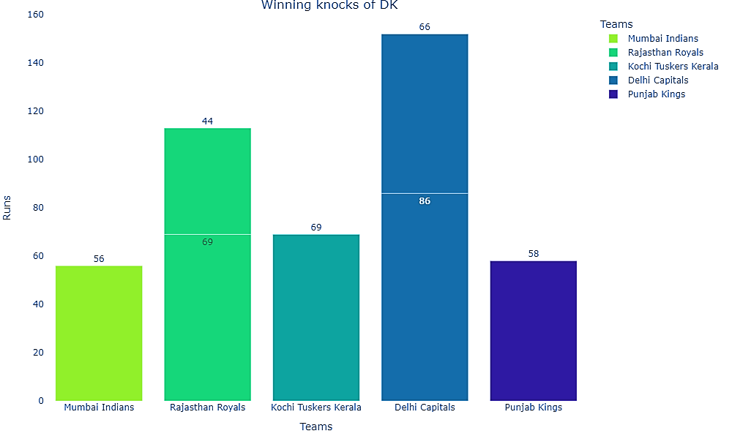
MATCH WINNING KNOCKS OF DK

Slide 47
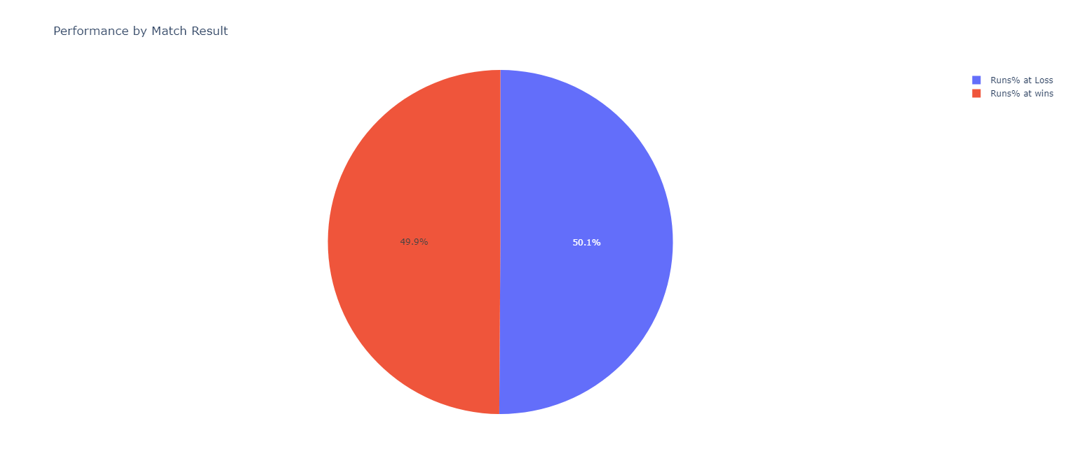
RATIO OF RUNS RESULTING THROUGHOUT THE IPL CAREER OF DK

Slide 48
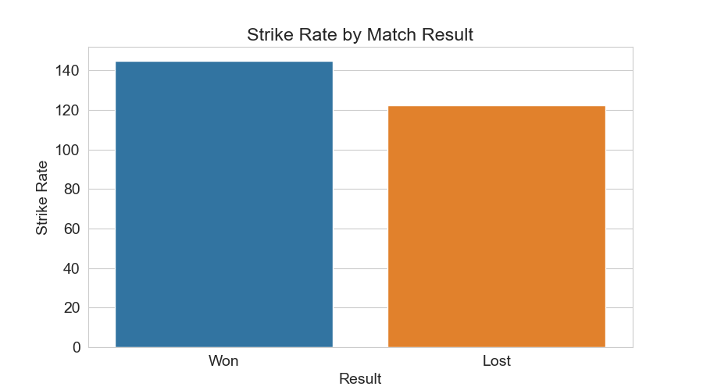
STRIKE RATE RESULTING THROUGHOUT THE IPL CAREER OF DK

Slide 49
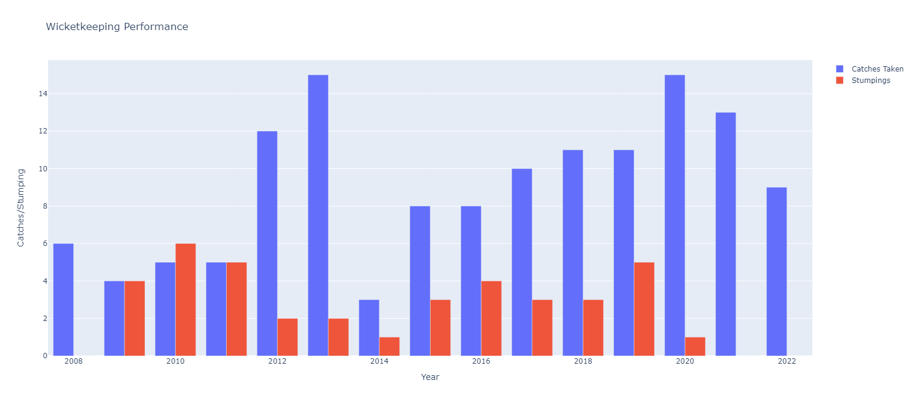
WICKETKEEPING PERFORMANCE OF MSD

Slide 50
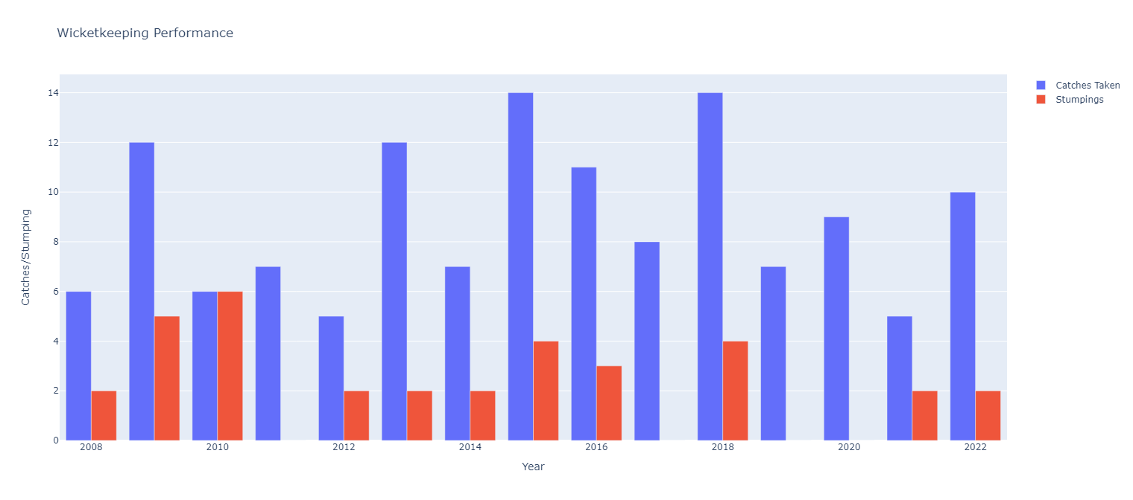
WICKETKEEPING PERFORMANCE OF DK

Slide 51
INFERENCE
MSD has an average of 47.39 and 17 fifties in the result of matches won and an average of 31.38 in the result of matches loss and got out on zero for only 4times.
MSD has the SR of 148.23 in the result of matches won and the SR of 120.00 in the result of matches loss.
MSD remains Not out for 51 times in 113 innings which leads to winning cause.
MSD remains Not out for 28 times in 98 innings but failed to win.
MSD High Score of 84* came against RCB but failed to win and interesting fact is they lost the match just by 1 run.
MSD has an average of 47.54 and Strike rate of 144.58 while batting at 5 .
This shows that if MSD performs well then it will be Positive result.

Slide 52
INFERENCE
DK has an average of 35.00 and 11 fifties in the result of matches won and an average of 21.79 in the result of matches loss and got out on zero for 13 times .
DK has the SR of 144.67 in the result of matches won and the SR of 122.35 in the result of matches loss.
DK remains Not out for 36 times in 98 innings in the result of winning.
DK remains Not out only for 9 times in 109 innings which results in losing.
DK High Score of 97* came against RR but failed to win and the lost the match in the final over.
DK has improved himself in the last season with Strike Rate of 183.33 and average of 55.0 which is most by him in any season. The main reason for this improvement is to play upcoming world cups
DK has an average of 34.57 and Strike rate of 180.60 while batting at No.5 in last edition of IPL

Slide 53
COMPARISON
MS Dhoni and Dinesh Karthik has played almost same of matches and innings, but MS Dhoni has a higher batting average and Strike Rate than Dinesh Karthik and more consistent in scoring runs.
MS Dhoni and Dinesh Karthik, both are capable of scoring big runs.
MS Dhoni has more number of sixes and Dinesh Karthik has more numbers of fours and both are capable of scoring boundaries.
The number of match-winning innings played by MS Dhoni is more than Dinesh Karthik who has had a greater impact on the outcome of matches..
Dinesh Karthik has improved himself as much as an finisher in last season by remaining notout for 9 times in last 16 innings.

Slide 54
CONCLUSION
Both MSD and DK had good IPL career but when we compared them MSD IPL career will be higher
We analyzed MS Dhoni and Dinesh Karthik dataset using different techniques and by plotting charts. Both got equal opportunities. For MSD the chart shows, the more innings he stays in crease, the more directly proportional the runs scored and win.
DK Karthik had a brilliant campaign, scoring 330 runs at a Strike Rate of 183. He was given the 'Super Striker of the Season' based on his performances throughout the course of the tournament.
Both MSD experience , DK form ,their leadership and wicketkeeping skills can work for their teams and age comes next to that. This is the reason for both players retained by their respective franchise.
MSD at No.5 and DK at No.7 will add more strength to their team.

